Slide 1

Computer Vision Introduction
Daniel Lopes, Data Scientist, Continental Tires, Lousado
Filipa Castro, Data Scientist, Continental Tires, Lousado

Slide 2
What is Computer Vision?
Computer Vision is a field in Artificial Intelligence that enable machines to derive meaningful information from visual inputs (images, videos) and take actions based on that information.
It works much the same as human vision, except humans have a head start. Human sight has the advantage of lifetimes of context to train how to tell objects apart, how far away they are, whether they are moving and whether there is something wrong in an image.
Reference: https://www.ibm.com/topics/computer-vision

Slide 3
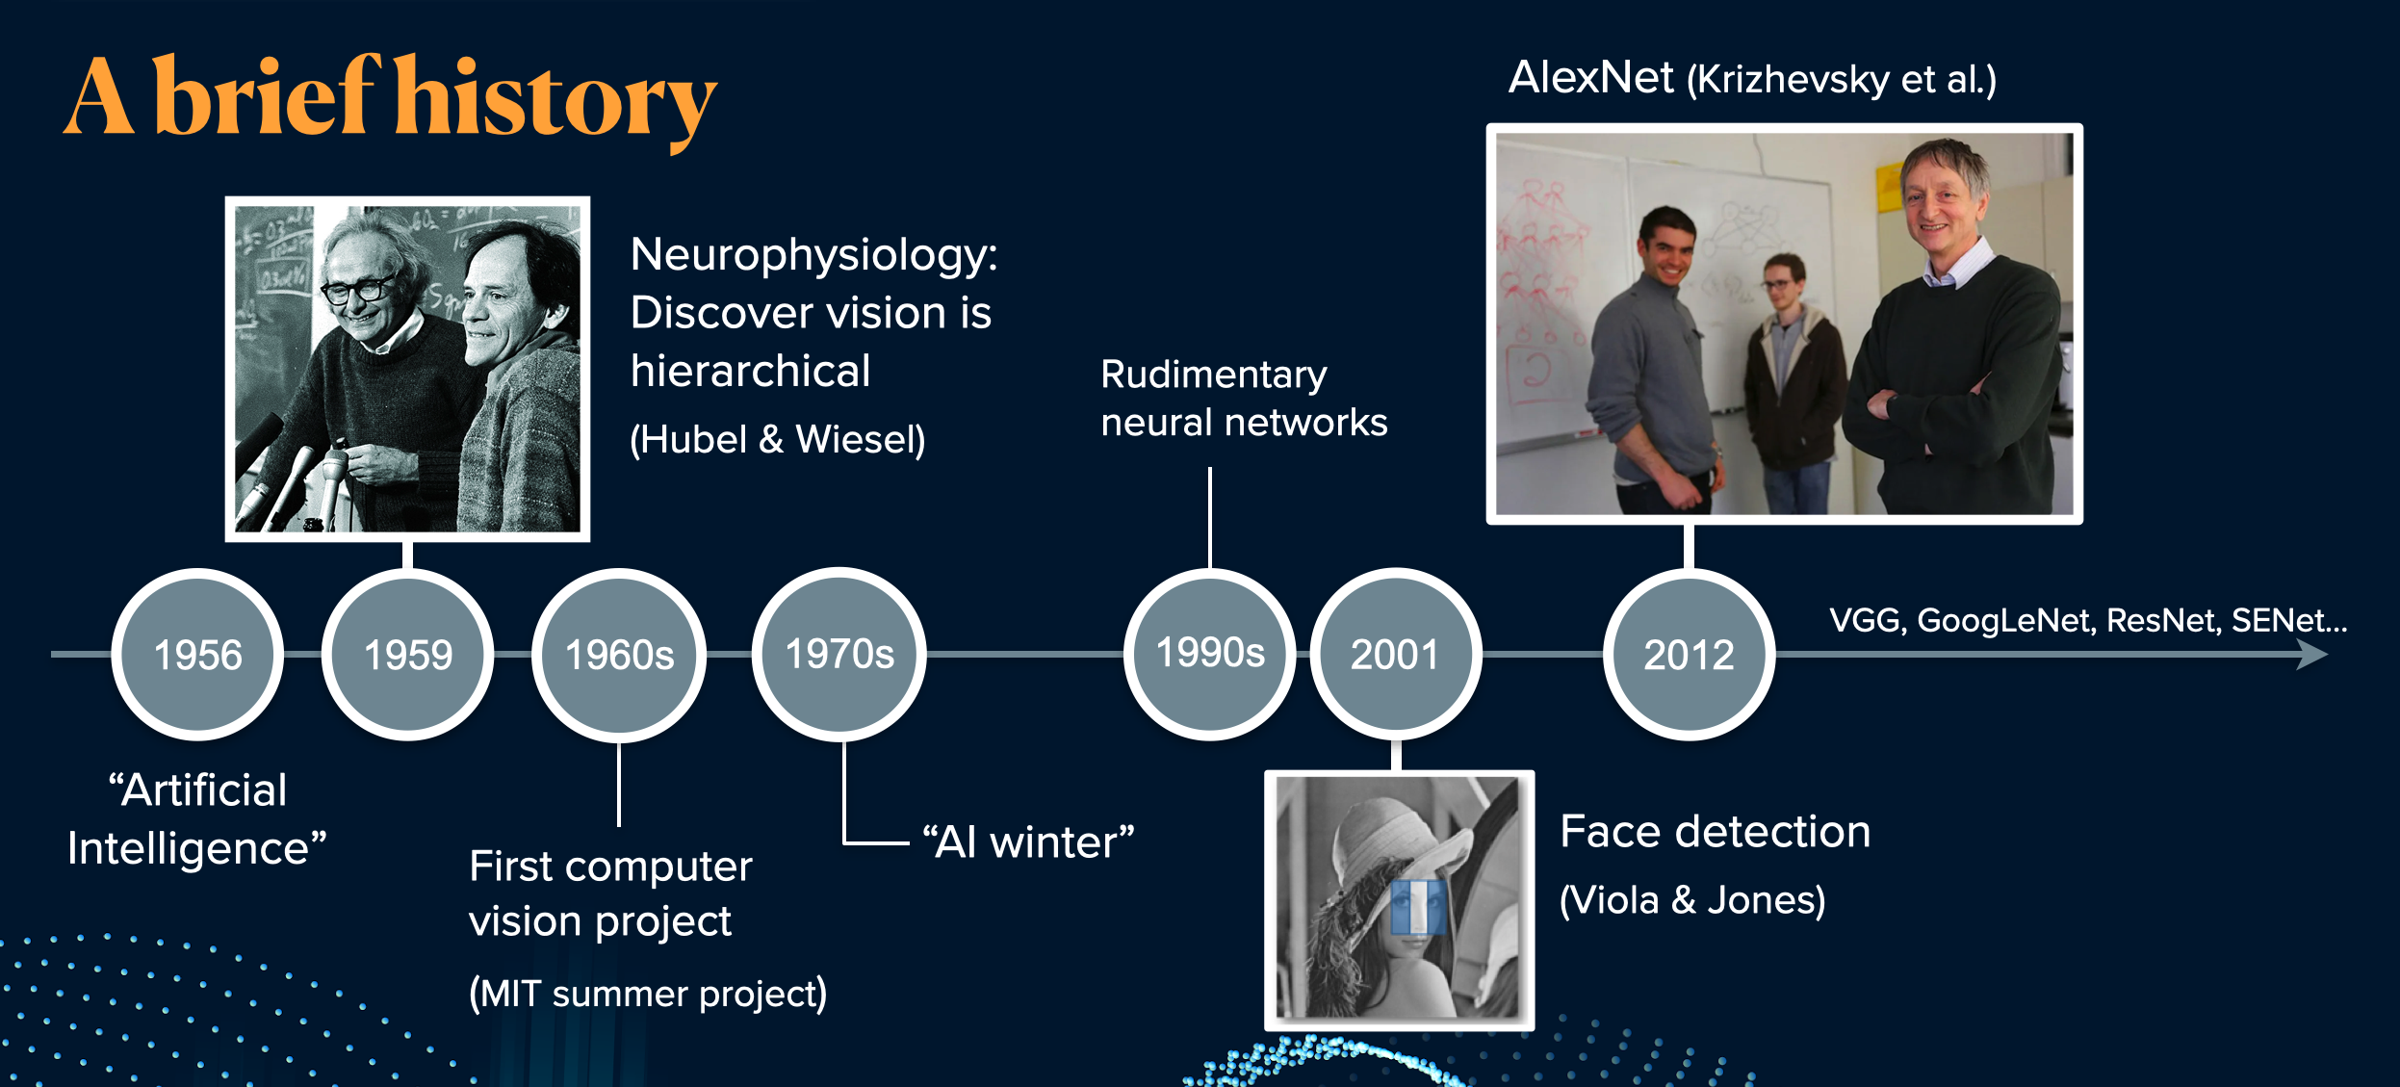
History of Computer Vision
Source: https://katiehuang1221.medium.com/an-introduction-to-computer-vision-131826e2b512

Slide 4
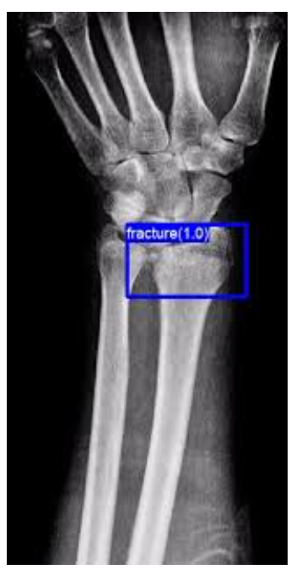
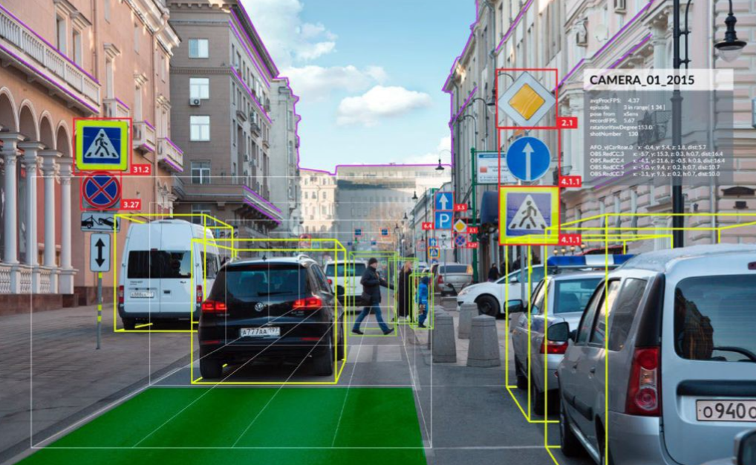
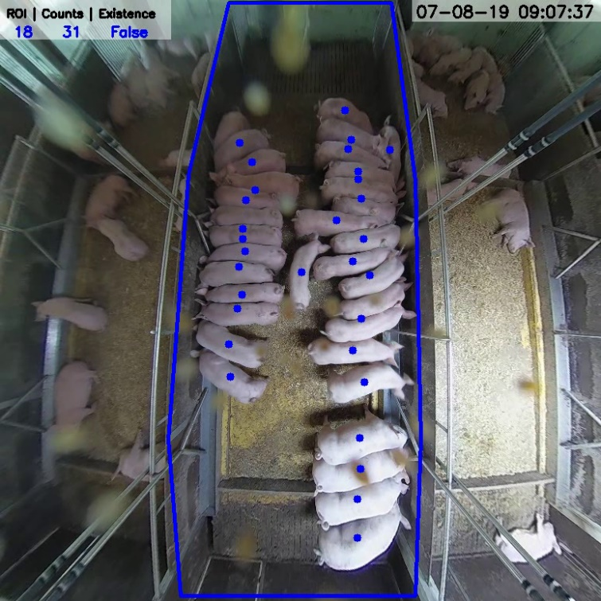
Fields where Computer Vision is used
Health systems
Autonomous driving
Agriculture

Slide 5
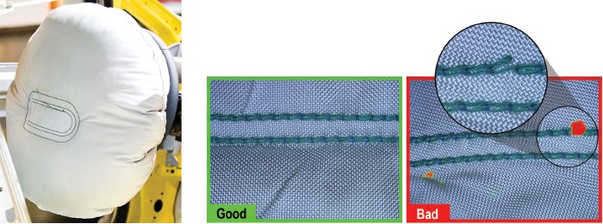
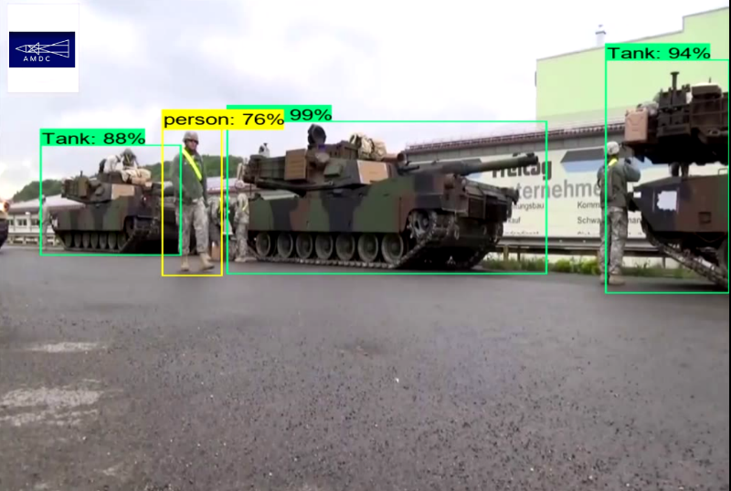
Fields where Computer Vision is used
Military
Manufacturing
And many more...

Slide 6
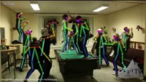
Examples

Slide 7
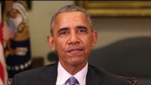
Example of the ethical problem in AI

Slide 8
In order to get to the point where we are developing advanced AI algorithms, we need to undestand the roots...

Slide 9
What is a digital image?
A digital image is a representation of a real image as a set of numbers that can be stored and handled by a digital computer. In order to translate the image into numbers, it is divided into small areas called pixels (picture elements).
For each pixel, the imaging device records a number, or a small set of numbers, that describe some property of this pixel, such as its brightness (the intensity of the light) or its color. The numbers are arranged in an array of rows and columns that correspond to the vertical and horizontal positions of the pixels in the image.
Reference: https://www.encyclopedia.com/computing/news-wires-white-papers-and-books/digital-images

Slide 10
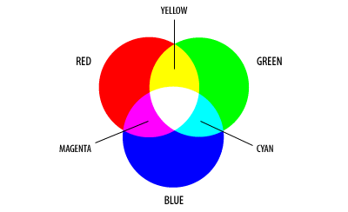
RGB format
Reference: https://www.encyclopedia.com/computing/news-wires-white-papers-and-books/digital-images

Slide 11
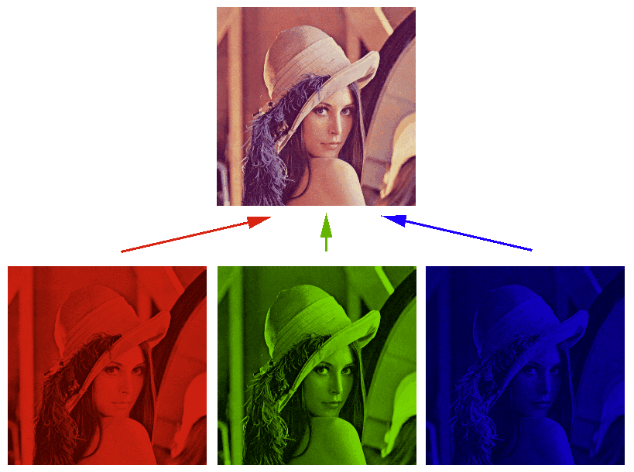
RGB format
http://spsprashanth.blogspot.com/2016/08/rgb.html

Slide 12
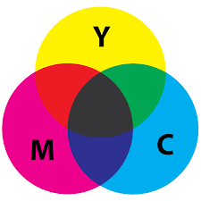
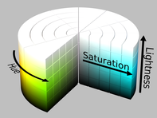

Alternative representations of RGB
CMYK
HSL
HSV
Reference: https://www.encyclopedia.com/computing/news-wires-white-papers-and-books/digital-images

Slide 13
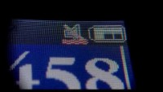
If you look closer to a LCD display...

Slide 14
Now, let‘s learn some algorithms...

Slide 15
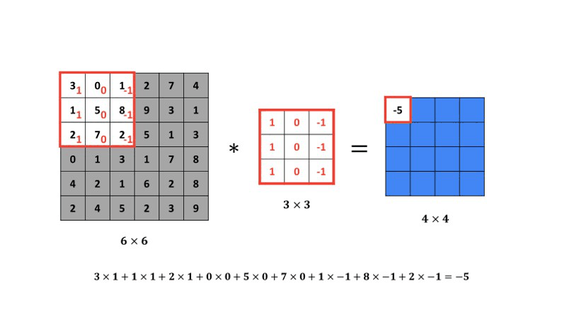
2D Convolution
The filter is actually a small matrix that we will use to sharpen or blur our original image. In order to do that we need to perform an operation of convolution.
Reference: http://datahacker.rs/004-how-to-smooth-and-sharpen-an-image-in-opencv/

Slide 16
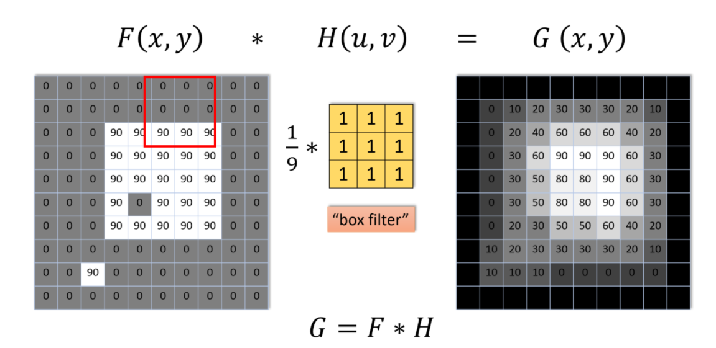
Blur/Smoth
Also called Averaging filter, all the coefficient values have the same value of 1/9. After we have applied convolution operator, we have generated our output image on the right.
Reference: http://datahacker.rs/004-how-to-smooth-and-sharpen-an-image-in-opencv/

Slide 17
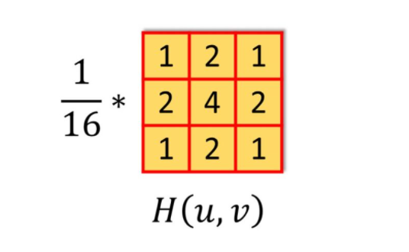
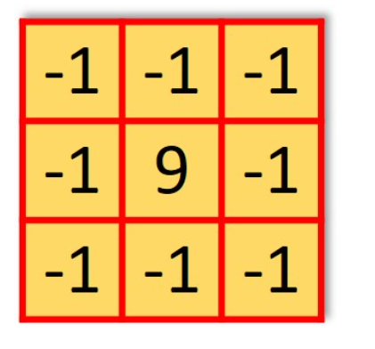
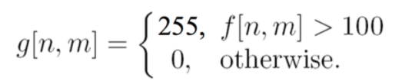
There are so many filters...
Gaussian Filter
(to blur the image)
High Pass Filter
(to sharp the image)
Threshold filtering
(to get a binary image)
Reference: http://datahacker.rs/004-how-to-smooth-and-sharpen-an-image-in-opencv/

Slide 18







Morphological Operations
Performed on binary images. Uses a kernel (filter) which decides the nature of the operation.
Erosion
Dilatation
Morphological Gradient
Opening
Top Hat
Closing
Reference: https://docs.opencv.org/master/da/d22/tutorial_py_canny.html

Slide 19
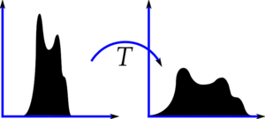
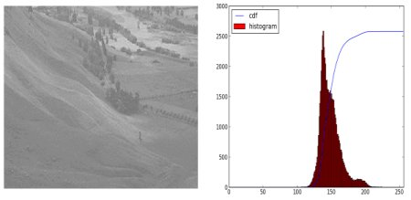
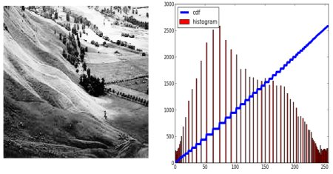
Histogram Equalization
Consider an image whose pixel values are confined to some specific range of values only. For eg, brighter image will have all pixels confined to high values. But a good image will have pixels from all regions of the image.
Reference: https://docs.opencv.org/master/da/d22/tutorial_py_canny.html

Slide 20
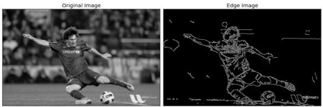
Canny Edge Detection
Multi-stage algorithm:
Noise reduction
Finding Intensity Gradient of the Image
Non-maximum Suppression
Hysteresis Thresholding
Reference: https://docs.opencv.org/master/da/d22/tutorial_py_canny.html

Slide 21
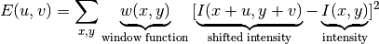
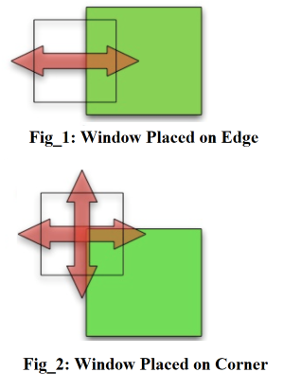
Harris Corner Detection
Difference in intensity for a displacement of (u,v) in all directions. This is expressed as below:
Reference: https://docs.opencv.org/master/da/d22/tutorial_py_canny.html

Slide 22

Hough Circle Transform
Hough Gradient Method uses the gradient information of edges.
Reference: https://docs.opencv.org/master/da/d22/tutorial_py_canny.html

Slide 23
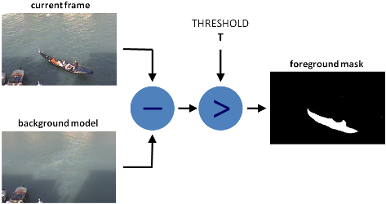
Background Subtraction
Background subtraction (BS) is a common and widely used technique for generating a foreground mask (namely, a binary image containing the pixels belonging to moving objects in the scene) by using static cameras.
Reference: https://docs.opencv.org/master/da/d22/tutorial_py_canny.html

Slide 24
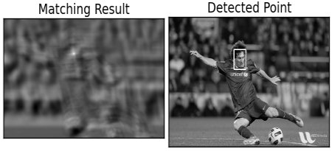
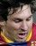
Template Matching
Template Matching is a method for searching and finding the location of a template image in a larger image. It simply slides the template image over the input image (as in 2D convolution) and compares the template and patch of input image under the template image.
Reference: https://docs.opencv.org/master/da/d22/tutorial_py_canny.html

Slide 25
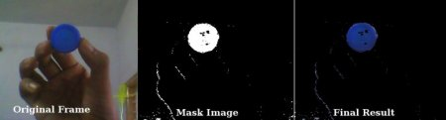
Object Tracking (by color)
Take each frame of the video
Convert from BGR to HSV color-space
We threshold the HSV image for a range of blue color
Now extract the blue object alone, we can do whatever on that image we want.
Reference: https://docs.opencv.org/master/da/d22/tutorial_py_canny.html

Slide 26
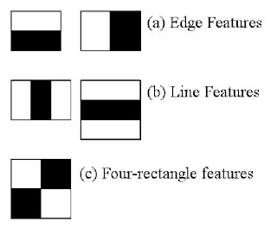
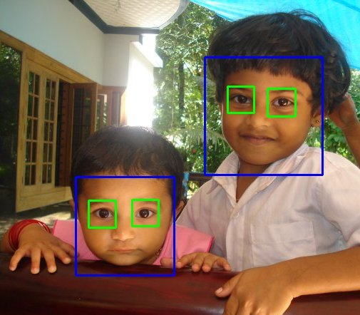
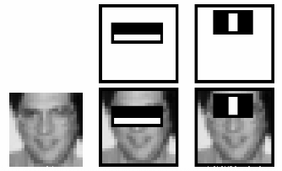
Face Detection (Haar Cascades)
Initially, the algorithm needs a lot of positive images (images of faces) and negative images (images without faces) to train the classifier. Then we need to extract features from it. For this, haar features shown in below image are used. They are just like our convolutional kernel.
Each feature is a single value obtained by subtracting sum of pixels under white rectangle from sum of pixels under black rectangle.
Reference: https://docs.opencv.org/master/da/d22/tutorial_py_canny.html

Slide 27
This so far were algorithms within was what is called „traditional computer vision techniques“. Now let‘s take a look of machine learning techniques.

Slide 28
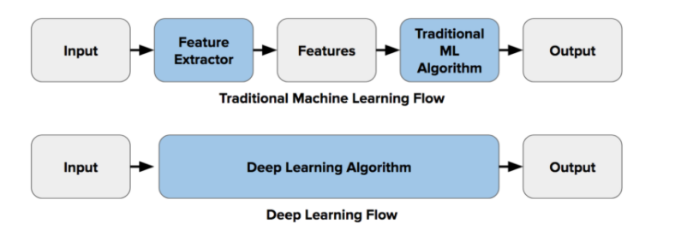
Traditional Computer Vision vs Deep Learning
Reference: https://docs.opencv.org/master/da/d22/tutorial_py_canny.html

Slide 29
Convolutional Neural Networks (CNNs)
A CNN is a neural network: an algorithm used to recognize patterns in data. Neural Networks in general are composed of a collection of neurons that are organized in layers, each with their own learnable weights and biases.
It has the following elements:
Tensor
Neuron
Layers
Kernel weights and biases
Reference: https://docs.opencv.org/master/da/d22/tutorial_py_canny.html

Slide 30
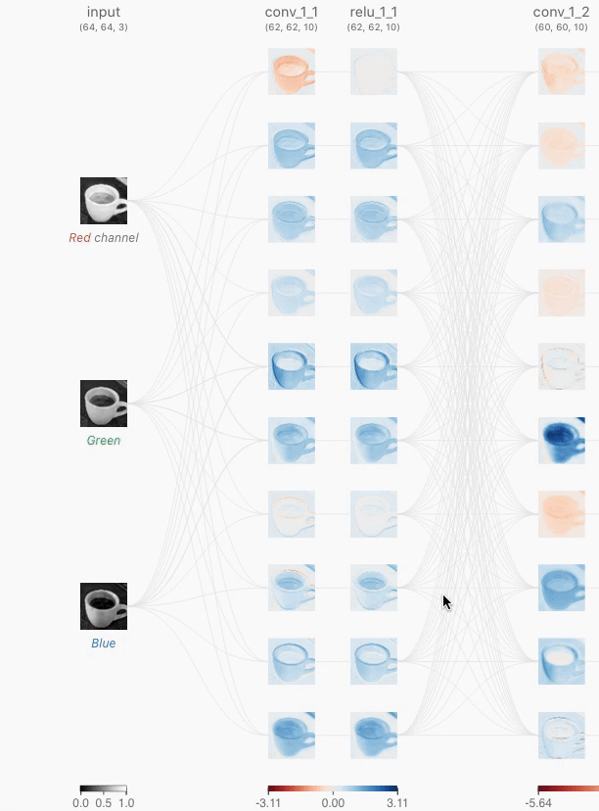
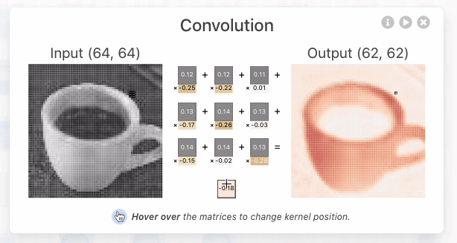
Convolutional Neural Networks (CNNs)
Reference: https://poloclub.github.io/cnn-explainer/

Slide 31
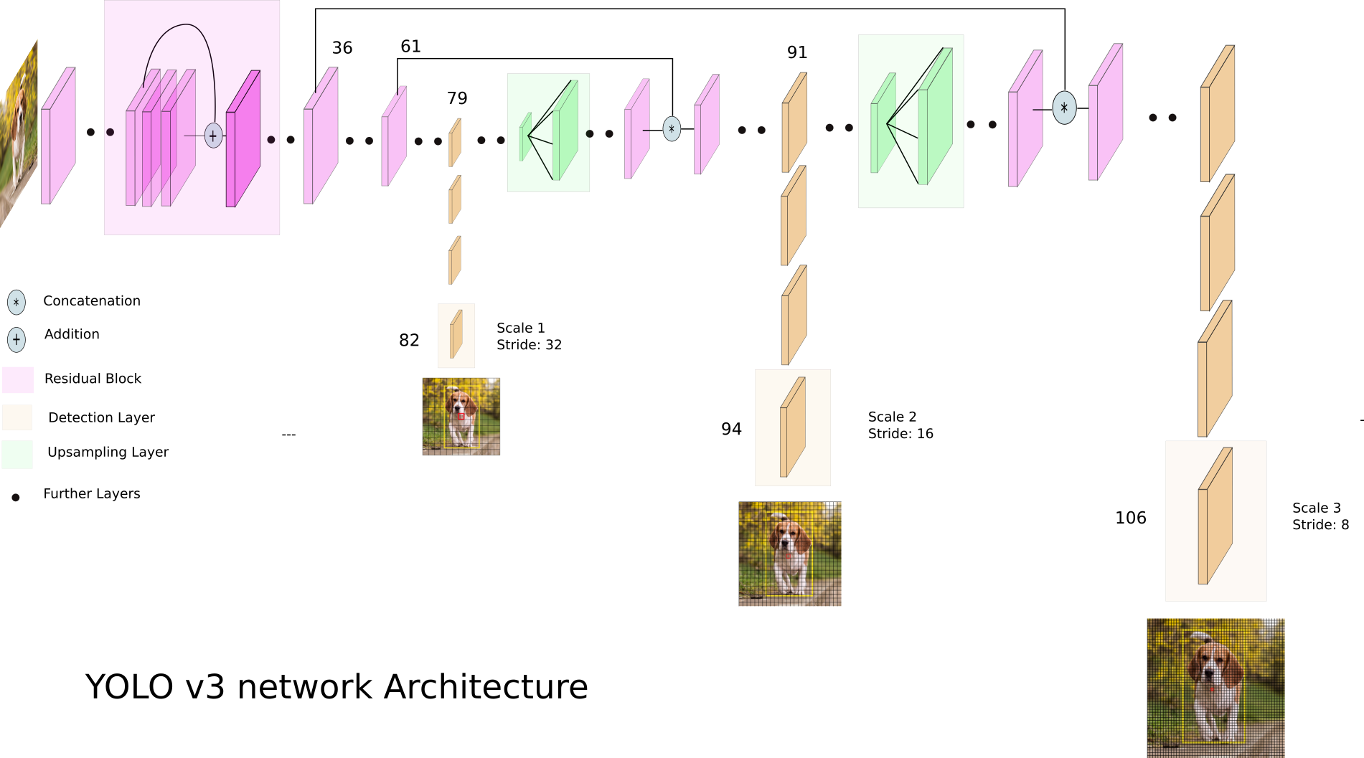
Deep Learning architectures are complex and hard to analyze!
Reference: https://poloclub.github.io/cnn-explainer/

Slide 32
If you feel interested about learning more CV we suggest:
OpenCV tutorials
Kaggle Computer Vision Tutorials
Digit Recognizer Challenge
Reference: https://docs.opencv.org/master/da/d22/tutorial_py_canny.html

Slide 33
Thank you!

